Slide 1
Cursed Is the One Who Hangs on a Tree
Deuteronomy 21:22-23

Slide 2
Deuteronomy 21:22-23
21:22 worthy of death- 19:6; 22:26
In the text hanging (hlt) on the tree (c[e) is not the means of execution of the wicked.
He is hung after death as a warning to others (Merrill, Deuteronomy, New American Commentary, 296; Josephus, Antiquities, 4.202)

Slide 3
Deuteronomy 21:22-23
The law does not demand the exposure of the criminal’s body in such a fashion, but assumes it.
21:23 You shall surely bury him on the same day- NASB “The Hebrew syntax is strongly emphatic” Thompson, Deuteronomy, Tyndale, 232

Slide 4
His body was to be taken down the same day: before sunset in Joshua 8:29; 10:26-27
The one who dies in such a fashion is accursed by God- Is God the subject or object of the curse?
Object: Idea that it is a great offence against God to mistreat the dead body
Subject: Idea the criminal’s death demonstrates the LORD’s wrath against sin

Slide 5
Bible Characters who were on a tree c[e
Some means of execution and others after death
Genesis 40:19 The chief baker
Joshua 8:29 The king of Ai
Joshua 10:26-27 The five kings of Canaan who fought against the Gibeonites
Esther 2:23 Bigthan and Teresh died on a gallows- Every time the NASB uses the term gallows in Esther the Hebrew word is tree

Slide 6
Bible Characters who were on a tree c[e
Esther 5:14; 6:4 prepared for Mordecai
Esther 7:9-10; 8:7 Haman ends up being killed
Esther 9:25-26 Haman’s sons killed

Slide 7
Bible Characters who were hung hlt
There is some overlap
Genesis 40:19, 22; 41:13 The chief baker
Joshua 8:29 The king of Ai
Joshua 10:26 The five kings of Canaan
Esther 2:23 Bigthan and Teresh
Esther 6:4 Haman’s plan for Mordecai
Esther 7:9; 8:7 Haman
Esther 9:13-14, 25 Haman’s son

Slide 8
Bible Characters who were hung
II Samuel 4:12 The murderers of Ish-bosheth: hung up after their execution
II Samuel 18:10 Absalom: hanging in an oak
II Samuel 21:12 The bones of Saul and Jonathan had been hung up by the Philistines
Lamentations 5:12 “Princes were hung by their hands; elders were not respected.”

Slide 9
Bible Characters who were hung
Apocrypha: Judith 14:1, 11 Holofernes- head hung
II Macc. 15:28- 33 Nicanor
New Testament: Matthew 27:5 Judas hanged himself- Not same word as LXX uses in Dt. 21:22-23, however, the Hebrew NT uses the same word

Slide 10
Jesus’ Death on a Tree
Acts 5:30 cross (NASB) is better tree (KJV, NIV) The word can be used of clubs (Luke 22:52) or stocks (Acts 16:24) but here of the cross
Acts 10:39
Acts 13:29 The context states Jesus had done nothing worthy of death (28) in contrast to the case in Deut. 21:22, echoes Lk. 23: 4, 14, 22

Slide 11
Jesus’ Death on a Tree
I Peter 2:24- The context has several quotations and allusions of Isaiah 53: 2:22/Is. 53:9; 2:23/Is. 53:7; 2:24/Is. 53:5; 2:25/Is. 53:6; but v. 24 “He Himself bore our sins in His body upon the tree” refers to Dt. 21:22-23; Polycarp’s Letter to the Philippians 8:1-2

Slide 12
Paul’s Use of Dt. 21:22-23 in Gal. 3:13
Galatians 3:13 Christ “became a curse for us” It may be that Paul quotes this verse because it was being used by Jews in their polemic against Christianity (Silva, Commentary on the New Testament Use of the Old Testament, 798)
Elsewhere Paul uses a different word for cross (I Cor. 1:17-18; Gal. 5:11; 6:12, 14; Phil. 2:8; 3:18)

Slide 13
Paul’s Use of Dt. 21:22-23 in Gal. 3:13
How does Paul use Dt. 21:22-23? He ties Dt. 27:26 (in Gal. 3:10) with Dt. 21:22-23 because of the common word curse and stresses, “Christ has endured the curse on the people’s behalf in order to redeem them from the curse pronounced on those who failed to keep the law” Bruce, Commentary on Galatians, 166

Slide 14
Can we speak of Christ dying for us?
The same Greek preposition that Galatians 3:13 uses of Christ dying for (uper) us is also used in Rom. 5:6, 8; 14:15; I Cor. 1:13; 11:24; II Cor. 5:14; Gal. 2:20; Eph. 5:2, 25; I Thess. 5:10; I Tim. 2:6; Titus 2:14; I Peter 2:21; 3:18; I John 3:16- all of which of speak of Christ dying
This same preposition is also used of Christ dying for sins in I Cor. 15:3-4; Gal. 1:4; Heb. 5:1; 7:27; 10:12

Slide 15
Can we speak of Christ dying for us?
The Greek preposition avvvnti is used of the death of Christ in Matthew 20:28; Mark 10:45.
It usually has the sense of instead of, in place of, and is used in Gen. 22:13; 44:33; Lev. 24:18; Num. 3:12; II Sam. 18:33 in the LXX and in Matt. 2:22; Lk. 11:11; James 4:15 in the NT.

Slide 16
The Curse/Shame of the Cross
From the Jewish point of view: It was hard for the Jews to accept their Messiah dying under the curse of God (I Cor. 1:23-24; Gal. 5:11; Heb. 12:2)
The Jewish Trypho “Be assured that all our nation waits for Christ; and we admit that all the Scriptures which you have quoted refer to Him…But whether Christ should be so shamefully crucified, this we are in doubt about. For whoever is crucified is said in the law to be accursed, so that I am exceedingly incredulous on this point” Justin Martyr, Dialogue with Trypho, chapter 89

Slide 17
Roman View of Crucifixion
Cicero (106-43 BC) called crucifixion “a most cruel and disgusting punishment” Cicero, Against Verres, Second pleading, book 5.64. Verres was a former governor of Sicily who was prosecuted by Cicero
“To bind a Roman citizen is a crime, to flog him is an abomination, to kill him is an act of murder: to crucify him is- What? There is no fitting word that could possibly describe so horrible a deed” Cicero, Against Verres, second pleading, book 5.66

Slide 18
Roman View of Crucifixion
“The very word ‘cross’ should be far removed not only from the person of a Roman citizen, but from his thoughts, his eyes and his ears….indeed the mere mention of them, that is unworthy of a Roman citizen and a free man” Cicero, In Defense of Rabiris, 5.16 (Murder Trials, Penguin, 1975, 277)

Slide 19
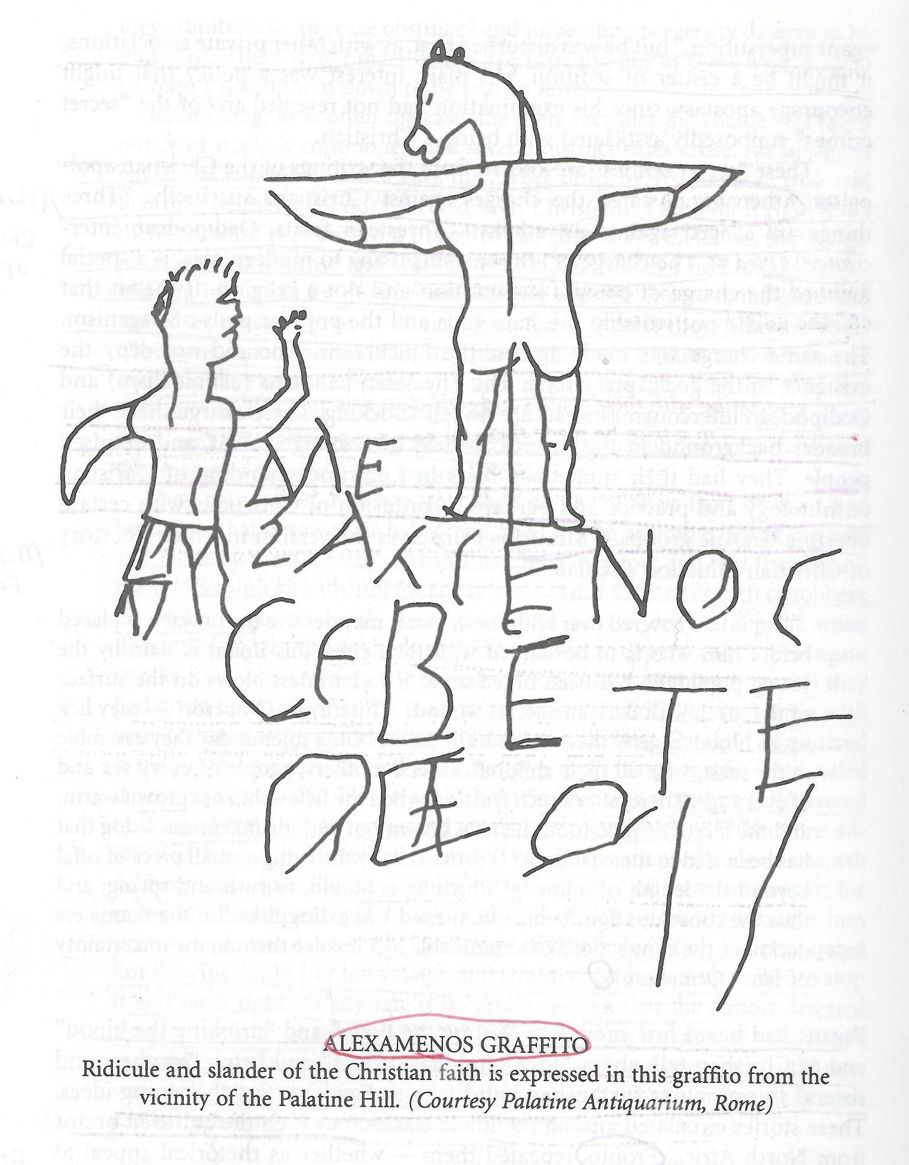
Picture from Rome- Ferguson, Backgrounds of Early Christianity, second ed, 560

Slide 20
Haman (the guilty) builds the gallows for Mordecai (the innocent) but ends up dying on his own gallows. But, Christ (the innocent) dies because of our (the guilty)sin/curse
Because woman and man took of the forbidden tree (Genesis 2:16-17; 3:1-7), they were barred from the tree of life (Genesis 2:9; 3:22-24). Christ had to hang on the tree (Acts 5:30; 10:39; 13:29; Galatians 3:13; I Peter 2:24) in order to us provide access to the tree of life (Revelation 2:7; 22:2, 14, 19)

Slide 21
Justin Martyr, Dialogue with Trypho, chapter 86, takes all kinds of pictures of trees in the Bible as pictures of the cross and tree of life (Ex. 15:25)

