Slide 1
An Introduction To Apocalyptic Literature
The Book of Revelation
Part 1

Slide 2
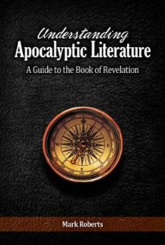
Introduction:
Understanding Apocalyptic Literature by Mark Roberts
Apocalyptic Literature

Slide 3
Introduction:
What is genre?
Revelation: Letter and Apocalyptic
Does genre really matter?
Apocalyptic Literature

Slide 4
NOT One-Of-A-Kind!
Biblical Examples: Daniel, Ezekiel, and Zechariah.
Extra-Biblical Examples: Enoch, Assumption of Moses, Apoc. of Baruch, 2 Esdras, Shepherd of Hermas, The Animal Apocalypse
Apocalyptic Literature

Slide 5
Why Choose Apocalyptic Style?
Always a response to a crisis.
Apocalyptic Literature

Slide 6
Psalm 137
¹ By the rivers of Babylon, There we sat down and wept, When we remembered Zion. ² Upon the willows in the midst of it We hung our harps. ³ For there our captors demanded of us songs, And our tormentors mirth, saying, “Sing us one of the songs of Zion.” ⁴ How can we sing the Lord’s song In a foreign land? ⁵ If I forget you, O Jerusalem, May my right hand forget her skill. ⁶ May my tongue cling to the roof of my mouth If I do not remember you, If I do not exalt Jerusalem Above my chief joy. ⁷ Remember, O Lord, against the sons of Edom The day of Jerusalem,

Slide 7
Psalm 137
Who said, “Raze it, raze it To its very foundation.” ⁸ O daughter of Babylon, you devastated one, How blessed will be the one who repays you With the recompense with which you have repaid us. ⁹ How blessed will be the one who seizes and dashes your little ones Against the rock.

Slide 8
Revelation 1:9
⁹ I, John, your brother and fellow partaker in the tribulation and kingdom and perseverance which are in Jesus, was on the island called Patmos because of the word of God and the testimony of Jesus.

Slide 9
Revelation 2:9-10
⁹ ‘I know your tribulation and your poverty (but you are rich), and the blasphemy by those who say they are Jews and are not, but are a synagogue of Satan. ¹⁰ ‘Do not fear what you are about to suffer. Behold, the devil is about to cast some of you into prison, so that you will be tested, and you will have tribulation for ten days. Be faithful until death, and I will give you the crown of life.

Slide 10
Revelation 3:10
¹⁰ ‘Because you have kept the word of My perseverance, I also will keep you from the hour of testing, that hour which is about to come upon the whole world, to test those who dwell on the earth.

Slide 11
Why Choose Apocalyptic Style?
Always a response to a crisis.
Why not just say, “God is in control”?
Apocalyptic Literature

Slide 12
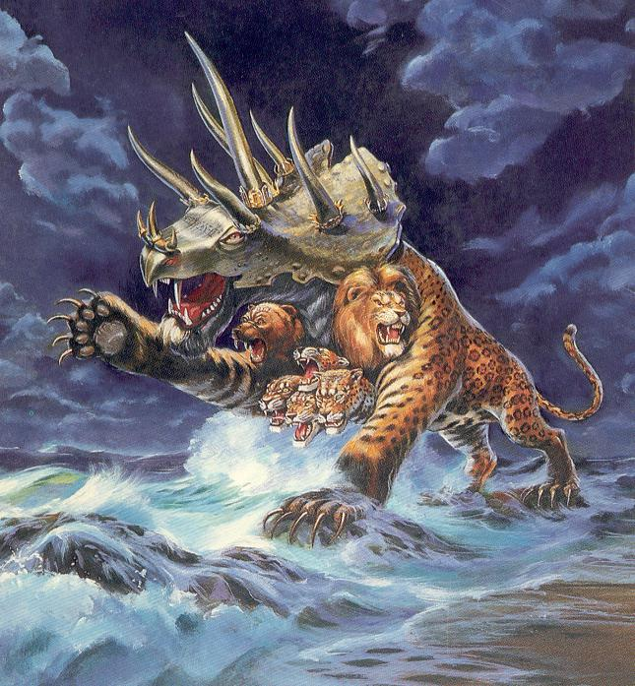
Which Makes A Deeper Impression On You?
We live in a society that is becoming more aggressive against our Christian values.
OR

Slide 13
Apokalupsis – Reveal/Uncover
“And after this I saw another dream, and I will show the whole dream to you my son" (1 Enoch 85:1).
"Blessed is he who reads and those who hear the words of the prophecy, and heed the things which are written in it; for the time is near." (Revelation 1:3).
Apocalyptic Literature

Slide 14
Apokalupsis – Reveal/Uncover
An apocalypse often explains its imagery.
Apocalyptic Literature

Slide 15
2 Esdras 5:4-10
But if the Most High grants that you live, you shall see it thrown into confusion after the third period; and the sun shall suddenly begin to shine at night, and the moon during the day. Blood shall drip from wood, and the stone shall utter its voice; the peoples shall be troubled, and the stars shall fall. 6 And one shall reign whom those who inhabit the earth do not expect, and the birds shall fly away together; 7 and the Dead Sea shall cast up fish; and one whom the many do not know shall make his voice heard by night, and all shall hear his voice. 8 There shall be

Slide 16
2 Esdras 5:4-10
chaos also in many places, fire shall often break out, the wild animals shall roam beyond their haunts, and menstruous women shall bring forth monsters. 9 Salt waters shall be found in the sweet, and all friends shall conquer one another; then shall reason hide itself, and wisdom shall withdraw into its chamber, 10 and it shall be sought by many but shall not be found, and unrighteousness and unrestraint shall increase on earth.

Slide 17
Revelation 7:9-17
⁹ After these things I looked, and behold, a great multitude which no one could count, from every nation and all tribes and peoples and tongues, standing before the throne and before the Lamb, clothed in white robes, and palm branches were in their hands; ¹⁰ and they cry out with a loud voice, saying, “Salvation to our God who sits on the throne, and to the Lamb.” ¹¹ And all the angels were standing around the throne and around the elders and the four living creatures; and they fell on their faces before the throne and worshiped God, ¹² saying, “Amen, blessing and

Slide 18
Revelation 7:9-17
glory and wisdom and thanksgiving and honor and power and might, be to our God forever and ever. Amen.” ¹³ Then one of the elders answered, saying to me, “These who are clothed in the white robes, who are they, and where have they come from?” ¹⁴ I said to him, “My lord, you know.” And he said to me, “These are the ones who come out of the great tribulation, and they have washed their robes and made them white in the blood of the Lamb. ¹⁵ “For this reason, they are before the throne of God; and they serve Him day and night in His temple; and

Slide 19
Revelation 7:9-17
He who sits on the throne will spread His tabernacle over them. ¹⁶ “They will hunger no longer, nor thirst anymore; nor will the sun beat down on them, nor any heat; ¹⁷ for the Lamb in the center of the throne will be their shepherd, and will guide them to springs of the water of life; and God will wipe every tear from their eyes.”

Slide 20
Apokalupsis – Reveal/Uncover
An apocalypse often explains its imagery.
No explanation = meaning was probably obvious to original readers.
We should be careful not to force meaning out of every detail!
Apocalyptic Literature

Slide 21
Apokalupsis – Reveal/Uncover
God is using a special style of writing with vivid imagery to reveal to His people that He will always overcome evil but it will happen on His time and in His way and their hope of heaven should motivate them to be faithful.
Apocalyptic Literature

Slide 22
An Introduction To Apocalyptic Literature
The Book of Revelation
Part 1

